Slide 1
WELCOME
COMBATING RACISM,
WEEK 4
BEING AN ALLY

Slide 2
Lamentation

Slide 3
Lamentation
Confession and Repentance

Slide 4
Lamentation
Confession and Repentance
Forgiveness

Slide 5
Lamentation
Confession and Repentance
Forgiveness
Rebuilding

Slide 6
He [Jesus] entered Jericho and was passing through it. A man was there named Zacchaeus; he was a chief tax collector and was rich. He was trying to see who Jesus was, but on account of the crowd he could not, because he was short in stature. So he ran ahead and climbed a sycamore tree to see him, because he was going to pass that way. When Jesus came to the place, he looked up and said to him, “Zacchaeus, hurry and come down; for I must stay at your house today.” So he hurried down and was happy to welcome him. All who saw it began to grumble and said, “He has gone to be the guest of one who is a sinner.” Zacchaeus stood there and said to the Lord, “Look, half of my possessions, Lord, I will give to the poor; and if I have defrauded anyone of anything, I will pay back four times as much.” Then Jesus said to him, “Today salvation has come to this house, because he too is a son of Abraham. For the Son of Man came to seek out and to save the lost.”
- Luke 19:1-10 (NRSV)

Slide 8
Racial reconciliation event

Slide 9
Racial reconciliation event
He was uncomfortable

Slide 10
Racial reconciliation event
He was uncomfortable
He listened – really heard someone – and knew he needed to understand more

Slide 11
Racial reconciliation event
He was uncomfortable
He listened – really heard someone – and knew he needed to understand more
Wants to find a way to spend his privilege

Slide 12
Racial reconciliation event
He was uncomfortable
He listened – really heard someone – and knew he needed to understand more
Wants to find a way to spend his privilege
Part of a group of people who don’t look like him

Slide 13
First
Pay attention to people who don’t look like you

Slide 14
Ijeoma Oluo defines racism as, “a prejudice against someone based on race, when those prejudices are reinforced by systems of power.” (So You Want to Talk About Race)
Tiffany Jewell says, “Racism is personal prejudice and bias AND the systemic misuse and abuse of power by institutions.”
(This Book is Anti-Racist)

Slide 15
The system was designed to produce the results you’re getting.

Slide 16
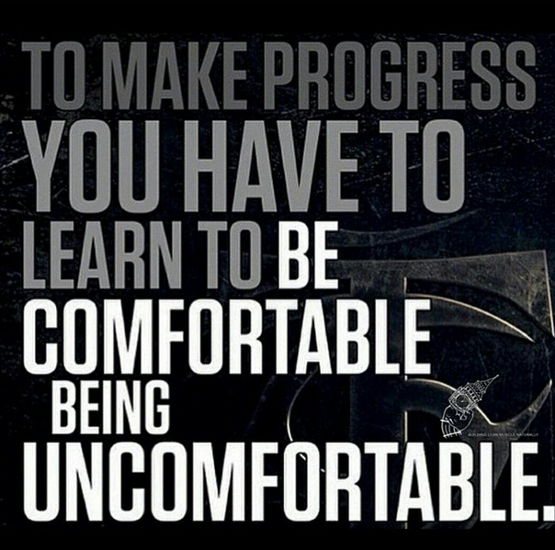

Slide 17
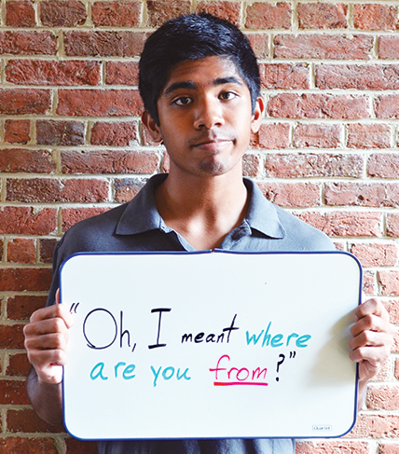
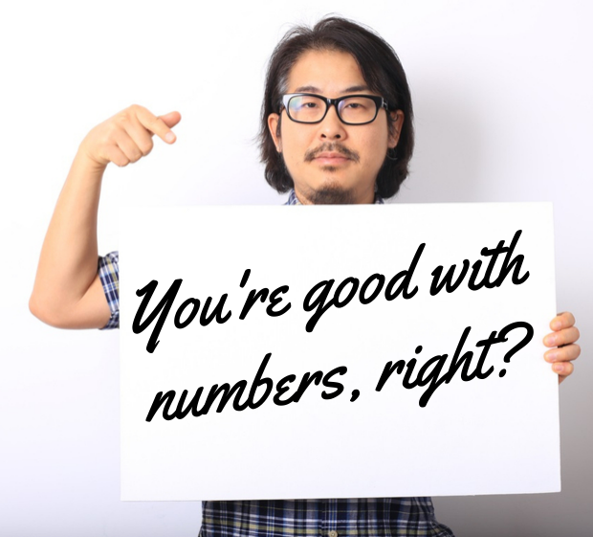
Microaggressions

Slide 18
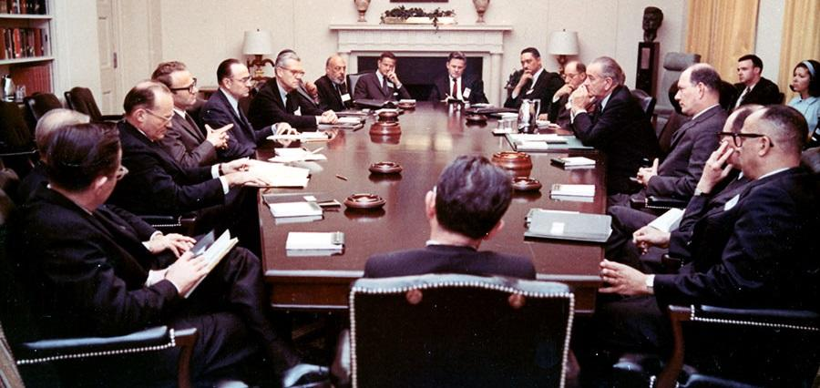
Who isn’t in the room?

Slide 19
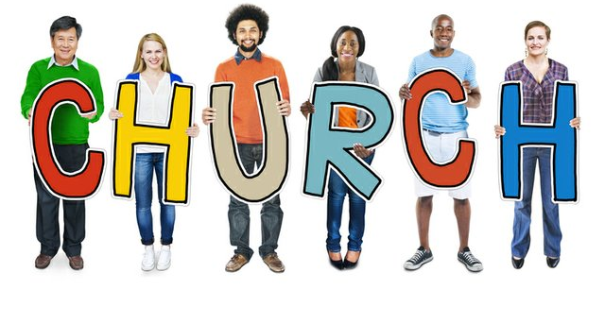
Does the church look like the community?

Slide 20
Second
If you see it,
say something

Slide 21
Ephesians 4:15-16
But speaking the truth in love, we must grow up in every way into him who is the head, into Christ, from whom the whole body, joined and knit together by every ligament with which it is equipped, as each part is working properly, promotes the body’s growth in building itself up in love.

Slide 22
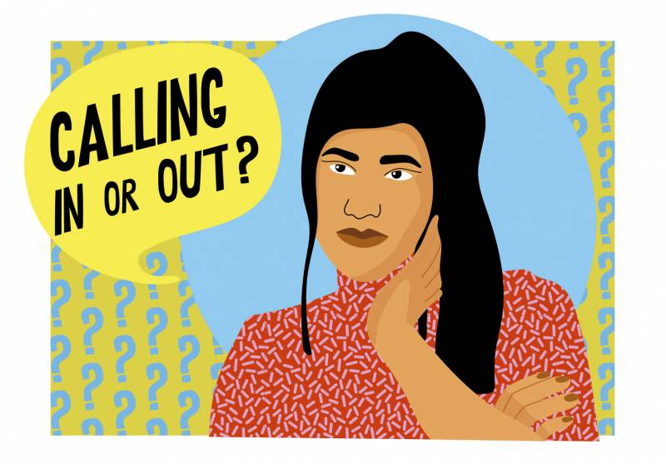
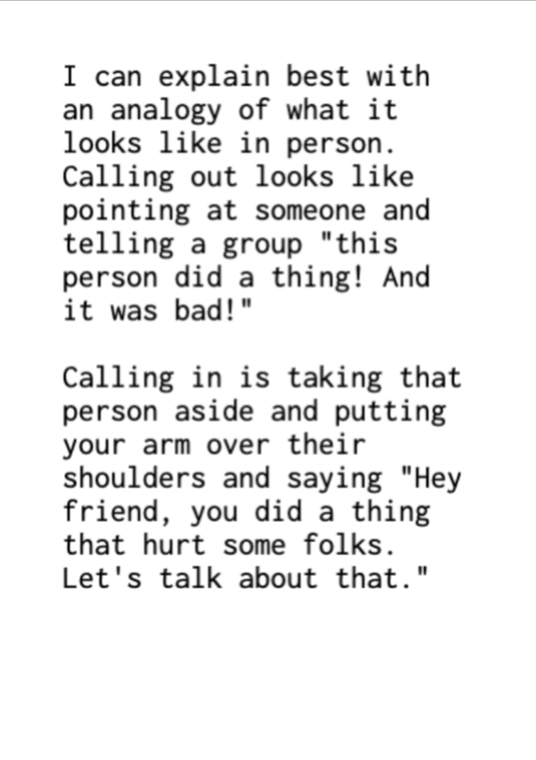

Slide 23
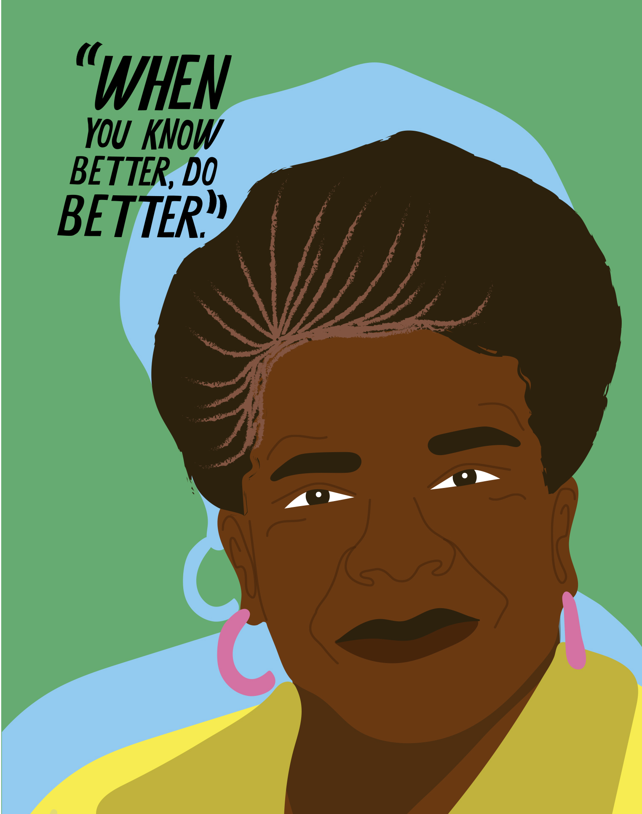

Slide 24
Third
Spend your privilege

Slide 25
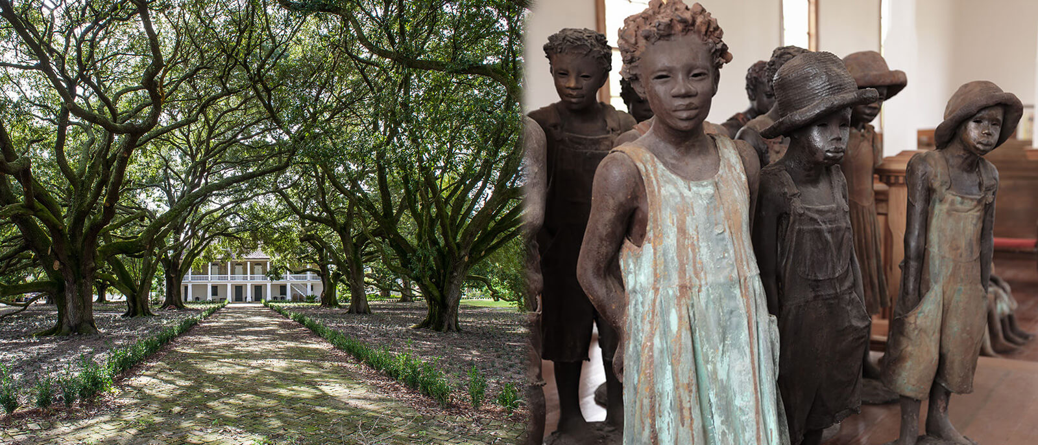
Whitney Plantation

Slide 26
Fourth
Get with people who can help

Slide 27
Jeremy was part of a group

Slide 28
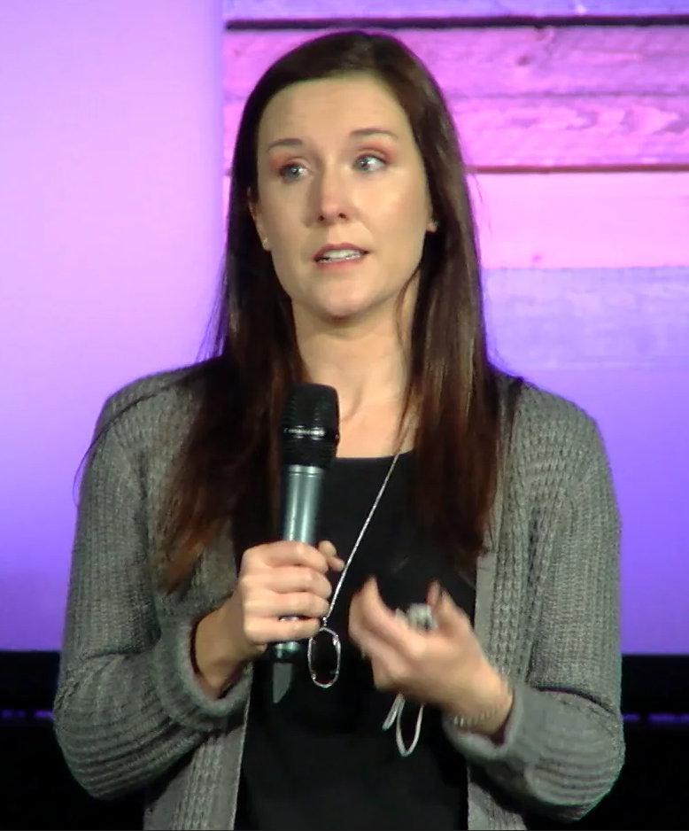
Be with people where you can make mistakes
and give & receive grace

Slide 29
Time and time again, God has shown me the power of bridge building, and through it God has given me a glimpse of heaven.
Latasha Morrison
Founder, Be the Bridge

Slide 30
